Slide 1
PROBLEM STATEMENT: SHAPE THE IDEA THAT YOU BELIEVE IN AND MAKE A DIFFERENCE

Slide 2
IDEA SOLUTION/PROTOTYPE
We are designing a multitasking application that will help women to learn, grow , teach and get help in various fields. This application will notify them about various programs and schemes being introduced for women.
This application can be easily used by women in rural and urban areas.
Along with an application, we will also design a website for women in minor area , who do not own a smart phone to register themselves through website from the nearest cyber center to get the access of this portal and receive updates timely.

Slide 3
WHAT ARE THE COMPONENTS OF OUR WEBSITE?
Learn: women can learn through the resourses which we will provide in our website
Grow: we will give chance to skilled women to share their skills and knowledge and get assistance for their startups by the government.
Teach: when a skilled women will teach other needy women it will be very usefull for them to get employed or do any startup.

Slide 4

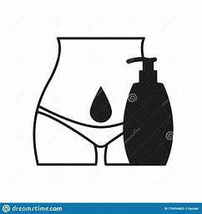




USE CASES:
Information regarding updates on going women’s schemes and employment
Information regarding protection provided by the government
Health and Hygiene knowledge and its sources
Access to nearby lady doctors
Making women’s aware of their Rights.
Startup ideas for skilled womens

Slide 5
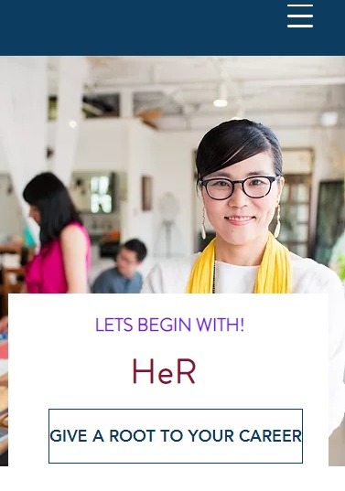
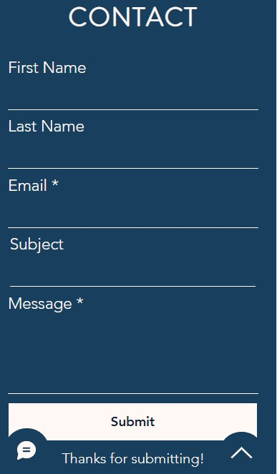
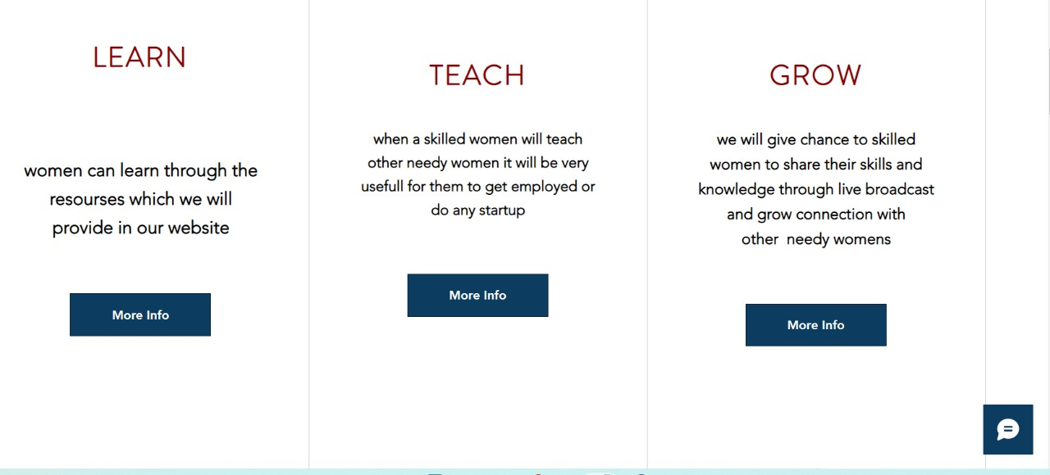
HERE IS A FRAMEWORK OF THE WEBSITE THAT WE ARE DESIGNING.

Slide 6
TECHNOLOGY STACK
FLUTTER
HTML
CSS
JAVA SCRIPT

